Slide 1
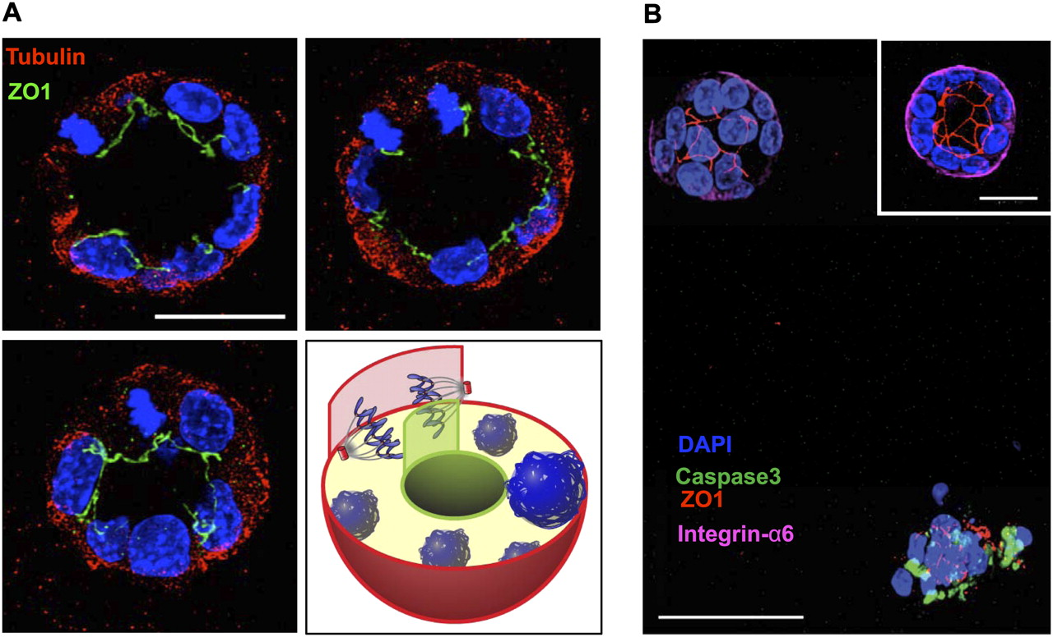

Primary mammary cells orient their mitotic spindle perpendicular to an apical surface and form a lumen without involvement of apoptotic mechanisms.
Jechlinger M et al. Genes Dev. 2009;23:1677-1688
©2009 by Cold Spring Harbor Laboratory Press
Notes:
Primary mammary cells orient their mitotic spindle perpendicular to an apical surface and form a lumen without involvement of apoptotic mechanisms. (A) Orientation of cell division in an expanding polarized acinus that is grown from primary nontransgenic mammary cells. One cell in anaphase is dividing with the two sets of chromosomes perpendicular to the apical surface, while keeping ZO1 localized to the luminal membrane; three adjacent projections (4 μm each) cover the center region of the sphere. (Top left panel) bottom projection. (Top right panel) Middle projection. (Bottom left panel) Top projection. The bottom right panel depicts the situation in a graphical sketch. (Blue) DAPI stain; (green) ZO1; (red) β-tubulin. Bar, 20 μm. (B) Confocal image of spheres that were grown from nontransgenic primary mammary cells, incubated with NucView substrate—a cell membrane-permeable fluorogenic (488 nm) substrate—before seeding into 3D gels. Gels were fixed 60 h after cell seeding. (Top left corner) Acinus displaying an intact lumen is negative for caspase3 and shows localized apical ZO1 (red) and basal Integrin α6 (magenta) staining. The insert shows 10-μm projection for better appreciation of the lumen.Bar, 20 μm. (Bottom right corner) Collapsed structure of cells displays green fluorescent cleaved substrate (no localized ZO1 and Integrin α6 staining). (Blue) DAPI staining; (green) NucView; (red) ZO1; (magenta) Integrin α6 (80-μm projection). Bar, 40 μm.

